Slide 1
Introduction to Software Architecture
CSCE 742 - Lecture 1 - 08/23/2018

Slide 2
Today’s Goals
Introduce The Class
AKA: What the heck is going on?
Go over syllabus
What you should already know
Clarify course expectations
Assignments/grading
Answer any questions
Cover the basics of software architecture

Slide 3
In the beginning…

Slide 4

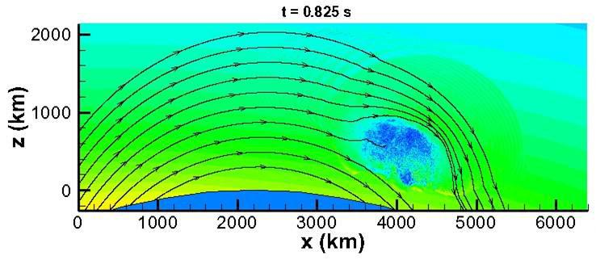
Software Was Small
Both physically…
And in scope.
Notes:
In the beginning, software was small. This was true physically - punch cards are annoying, computing power was limited. By necessity and because of lack of experience, in scope too. Important - very important - but focused on particular problems. Missile trajectories, Simulations, wargames, code breaking. Single task - no API or code reuse, limited functionality

Slide 5
Software Starts to Grow Up
Languages like C introduce file linking.
Enables organization of code and reuse of code.
SIMULA-67, Smalltalk introduce objects.
Enables organization of code into focused units that work with other objects to perform larger tasks.
Sections of the code “activate” when needed.
We can group together related functionality, ignore unrelated functionality, and find what we need when making changes.
Code can be reused in future projects.
Notes:
Then, however, our experience andcomputing power grew and matured, and we started to expand our ideas of what could be done with software.

Slide 6
Flash forward to the present day...
Notes:
Just start with a question - want you to start thinking about this. (read)
This isn’t something with one answer, or even a right answer. It’s something we’ll keep returning to

Slide 7

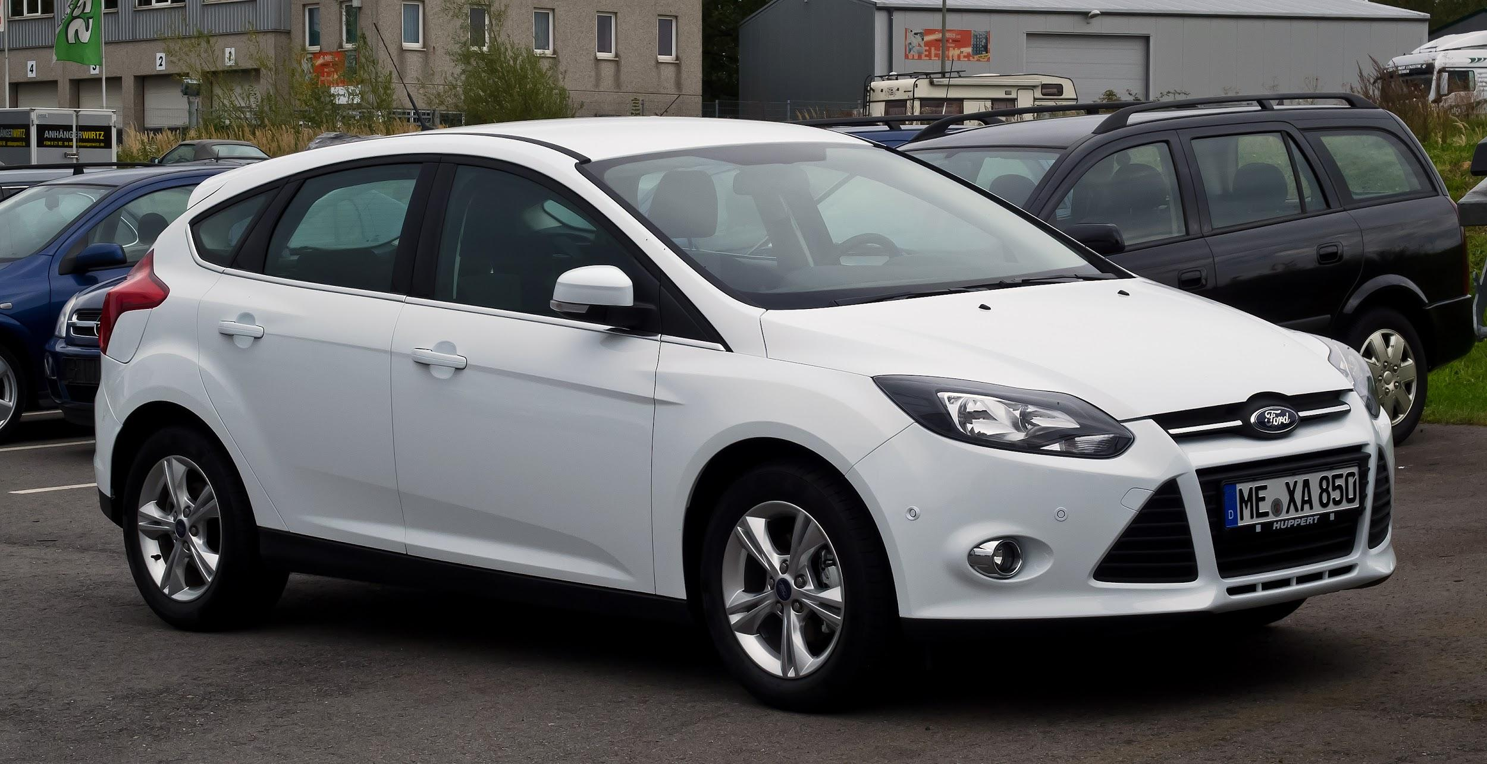

Our Society Depends on Software
This is software: So is this:
Also, this:
Notes:
The scope has expanded.
Amazon, of course, is software. No one disputes that. If I ask you about software, you’d mention something like this - a web app, a video game, a word processor. That’s not all that is software though - Our society is built on software. It powers our homes, it manages our private information, it controls our cars, it automates our factories and it even regulates our bodies. Ford is one of the largest software makers in the country. It is incredibly important that we construct good software. We need robust, operational systems, especially given growing demand for features, limited development budgets and strict time constraints.

Slide 8
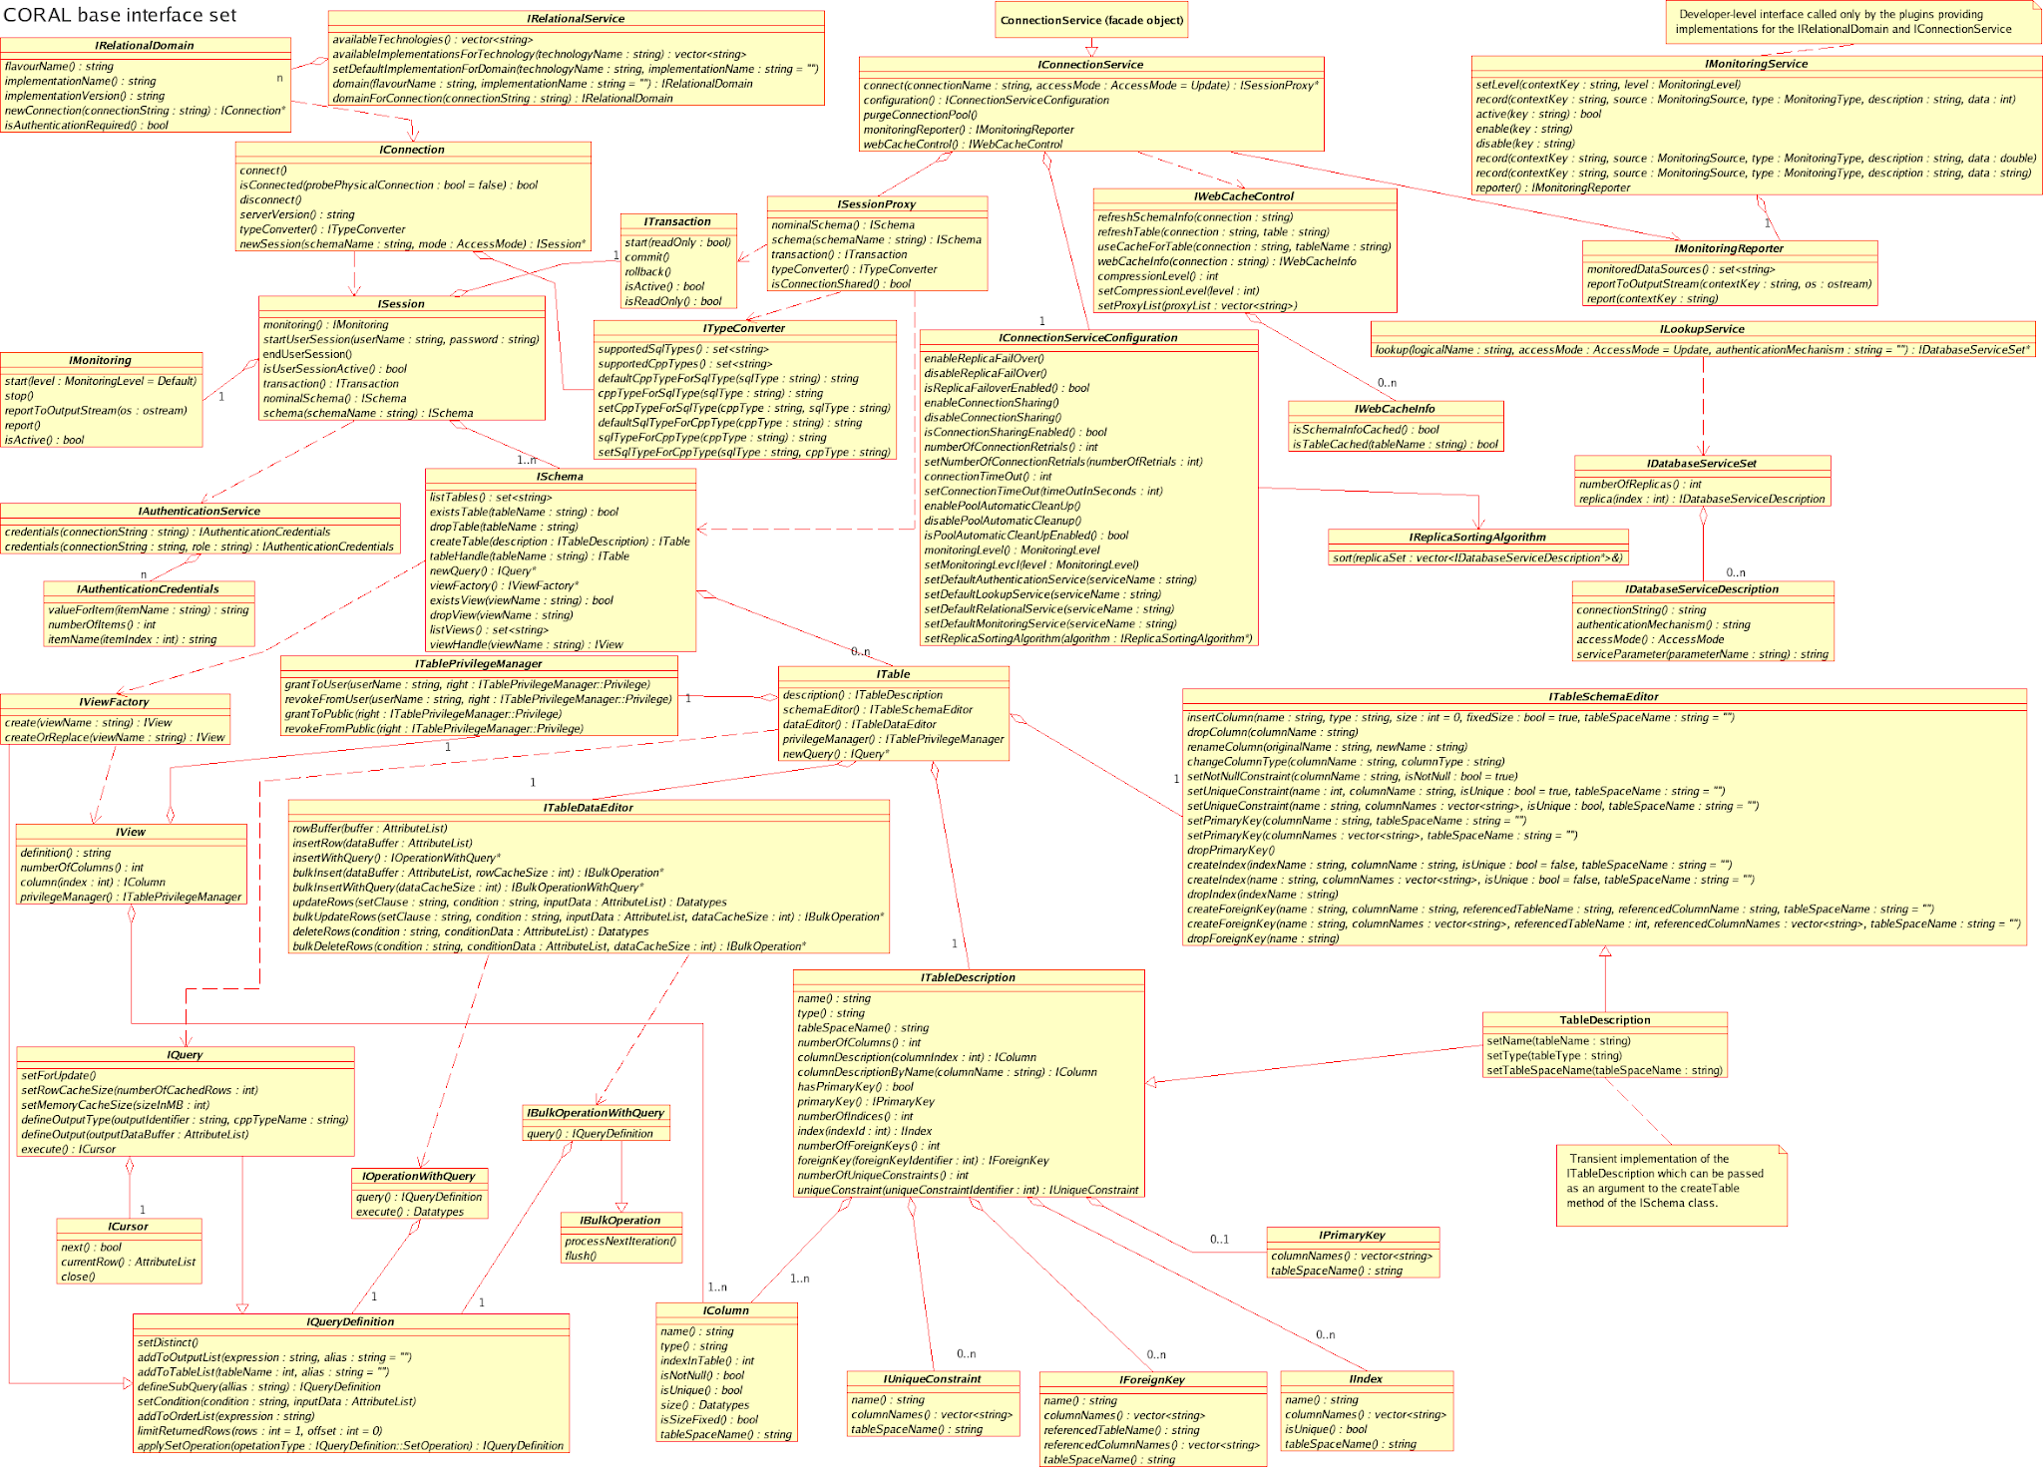
Under the Hood
Systems have millions of lines of code.
Divided into hundreds of classes.
Notes:
However, growth in scope means growth in the size and complexity of the code base. (1-2). If not more - it came out last year that Facebook’s iOS app had 18000 classes. Now, this is a bit more than usual, and partially the result of automated code generation. However - hundreds is common. Keeps growing.

Slide 9
Growing Pains
No person can understand an entire million-line codebase.
Classes organize code, but how can you find the right clases when there are thousands?
Results in chaos.
Only 16.1% of projects delivered on time and within budget, with all planned features complete as specified.
31.1% of projects are cancelled before delivery.
Delivered projects may be slow, insecure, missing features, have duplicate code, go down often, etc.
Notes:
Ultimately, this growth is good - we can do incredible things with software that were impossible before. But it comes at a cost, and there are some growing pains. (go over)

Slide 10
The Concept: “Architect” Software
The key to delivering robust software?
Designing an understandable, organized system.
AKA: “taming the complexity”
Architecting software is the practice of partitioning a large system into smaller ones.
That can be created separately
That individually have business value
That can be straightforwardly integrated with one another and with existing systems.
Notes:
So, the key to delivering robust software is through a thorough design process (go over). This is one of, if not the most important task you perform when developing software

Slide 11

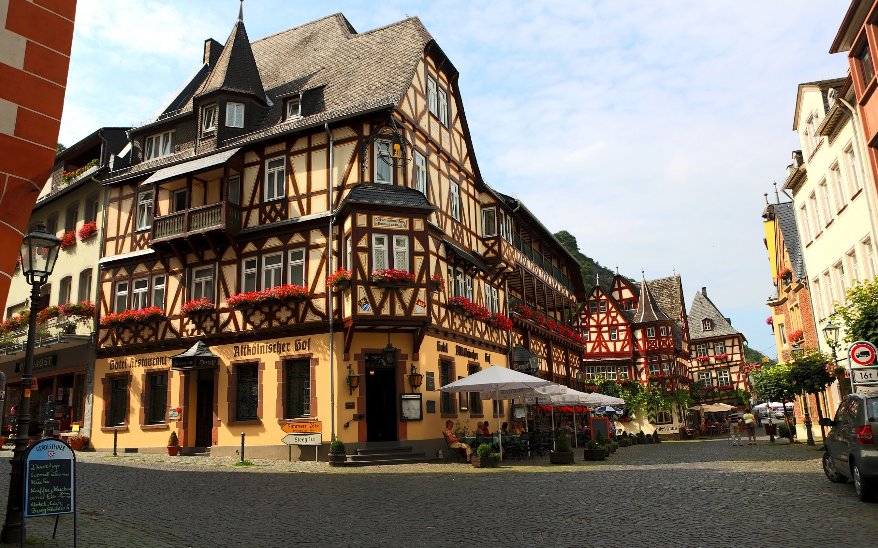

Architectural Styles
Notes:
Let’s talk about buildings. You see a few on this slide, you’re in one right now. Good, solid engineered products. Now, the buildings on this slide are all very different - you’ve got a castle, you’ve got a skyscraper, you’ve got some kind of german beer hall thing. They’re still different versions of the same fundamental concept - a permanent structure to protect inhabitants from the elements, offer privacy to conduct business or live, and all of those other things we use buildings for. But, each does belong to a distinct category. The top left one is clearly a castle. Every castle has its variations, but they are still distinctly castles. Same for skyscrapers. All skyscrapers are a little different, but they are built using the same materials, with similar support structures, elevator placement, hvac structures, and so on. So, over time, we see styles of building appear - different architectures that, although they allow variation, enable us to take the lessons learned from others of that type and distill those into new buildings. When you go to build a skyscraper now, there isn’t much need for experimentation, there isn’t much cause to worry that it’ll all collapse. We know how to build a skyscraper because we have a template to follow - a framework we can be creative within, but still offers structure. Software offers similar architectural styles that can inform and structure the design of new projects.

Slide 12
What is Software Architecture?
“Software architecture is the fundamental organization of a system, embodied in its components, their relationships to one another and the environment, and the principles governing its design and evolution.”
IEEE Definition
Notes:
Software is intangible - we keep repeating this point. So, if we can’t easily touch or see the structure of the software, what does architecture mean when talking about software? In truth, it’s pretty much the same as what it means for a building. The IEEE defines software architecture as: (read).
The key difference is a mental one - it’s harder to see problems in a structure of software, as any visualization is an artificial one, but it is just as important - if not more so - to lay down the proper blueprint.

Slide 13
Architectural Design
First stage of design.
Partitions the requirements into self-contained subsystems.
Later, each subsystem will be decomposed into one or more classes.
Plan how those subsystems cooperate and communicate.
Notes:
Planning the architecture of a system is the first step in design. It’s how we take this idea of a monolithic system, break it down into independent layers and subsystems, and structure how those parts connect. Before we design classes, before we choose algorithms, we should take the idea we have, the list of features, and broadly lay out how we will deliver that functionality.
(2), portions of the software responsible for certain features, and (4) to deliver the promised functionality.
(3), but for now, we’re concerned with the design at a higher level. Before we can effectively lay out the classes, we need to lay down a broader structure

Slide 14
Architecture Parallels
Architectural plans are the technical interface between the customer and the contractor building the building.
(and the software)
A bad architectural design for a building cannot be rescued by good construction.
(same for software)
There are specialist types of building architects and architecture styles.
(you get the point)
Notes:
It turns out that building architecture and software architecture have many parallels
Architects and their blueprints are (read). Same for software - the customer who has ordered the software rarely has a clue how development works. Your architectural design offers a way to explain how the system works in a manner that the customer can understand and offer feedback on
(read) If your building design stinks, good materials and talented construction workers won’t save it. Same for the software. No matter how good your coders are, if the system is badly designed, it will be bad. It might be slow, it might be insecure, it might go offline way too often. A bad design will get you in trouble.
(read). You get the idea. Just as there are skyscrapers and castles and other distinct types of buildings, we see dozens of software types out there, and unique architectural styles appropriate for those pieces of software. Having some knowledge of what architecture fits a particular type of system is a good way to get ahead as a software engineer.

Slide 15
Why Explicitly Plan Architecture?
Enable stakeholder communication
High-level presentation of the system.
Enables system analysis
Can look for problems before coding.
Enables large-scale reuse
Planning subsystems as independent entities allows their reuse in other systems.
Bad architectural design means bad security
Controlling access is the first line of defense.
Notes:
Why plan our architecture? Why explicitly sit down and talk about it? There are a few key reasons
-Enables stakeholder communication. The architecture is a high-level presentation of the real system that can be used to get feedback from customers. The requirements specification is more for you, it’s your guide to what to build. The architecture gives you the means to go back to the customer and explain to them what you’re doing and how it will ensure that their requirements are met.
- It enables system analysis. Making the architecture explict means you can look for problems in it before coding even starts. You can analyze how subsystems communicate, how access to the system is managed, how the indpeendent parts integrate to provide functionality. This is good, because your architecture has a huge impact on performance, reliability, and maintenance of the system.
-It enables code reuse. If you architect your system well, you can take parts of it and reuse them in future projects. The same applies to your current project - a well-designed architecture can also enable you to slip in code from other projects and integrate it without much trouble.
- Fundamentally, (read). A huge part of security is controlling access to critical parts of your system
Good things are well-architected. Those are the kind of systems that stick around, that outlive their original purpose, that are robust. So, get that right.

Slide 16
In This Course, We Will Discuss...
The purpose and role of architecture in the overall process of software development.
As a process (architecting a system) and an artifact (the architecture of a system).
Similarities and differences between "design" and "architecture".
Notations/tools to assist software architects.
Processes that lead to good architectural outcomes and architectural refactoring.
Notes:
The goal of this course is to master skills that support this partitioning.
We will discuss the purpose and role of architecture in the overall process of software development, both as a process (architecting a system) and an artifact (the architecture of a system). We will also examine and debate the similarities and differences between "design" and "architecture". We will examine notations and tools designed to assist software architects and processes that can lead to good architectural outcomes and architectural refactoring.

Slide 17
Desired Course Outcomes
The students will be able to work from stakeholder requirements to create partitionable systems.
... use different viewpoints to document software architectures to different stakeholders.
… understand architectural quality attributes and how to use perspectives to assess how well the architecture meets them.
… apply and understand architectural patterns to quickly examine architectural alternatives and choose between them.
… clearly present and advocate architectural ideas.
Notes:
read off

Slide 18
Lecture Plan (approximate)
Introduction and Fundamentals of Architecture (1 week)
Introduction to Viewpoints, Perspectives, and Architectural Definition (1 week)
Context, Concerns, Stakeholders, and Quality Attributes (1 week)
Scenarios and Components (1 week)
Architectural Styles (4 weeks)
Viewpoints (2 weeks)
Perspectives (2 weeks)
Other Topics (1-2 weeks)
Notes:
read off, not linear

Slide 19
Contact Info
Instructor: Greg Gay (Dr, Professor, $#*%)
E-mail: ggay@cse.sc.edu
Office Hours: T/Th, 4:00-5:00 PM, 2247 Storey Engineering and Innovation Center
Website:
http://dropbox.cse.sc.edu/course/view.php?id=95
(Main website - will be used for course material and assignment submission)
http://greggay.com/courses/fall18csce742/
(Static backup - somewhat behind, but useful if above is down)
Notes:
read off

Slide 20
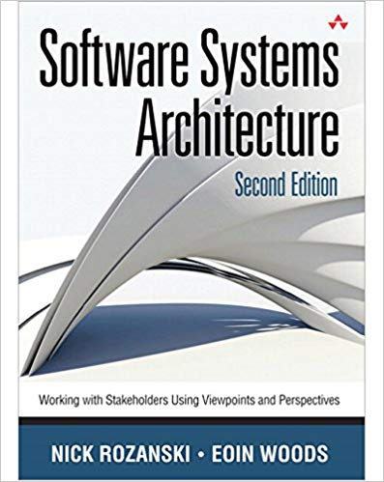
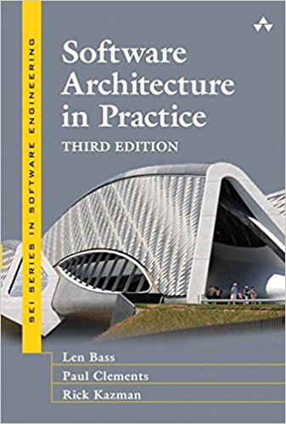
Textbook
There is no required book. Source material is drawn from:
Software Systems Architecture: Working With Stakeholders Using Viewpoints and Perspectives (Second Edition). Nick Rozanski and Eoin Woods.
Software Architecture in Practice (Third Edition). Len Bass, Paul Clements, Rick Kazman.
Additional readings
4-5 over the semester
Will be made available on webpage
Notes:
This course has no required textbook. However, the following books are the source of most of the covered material and will provide background not covered in class. Not required, recommended - will help illustrate concepts

Slide 21


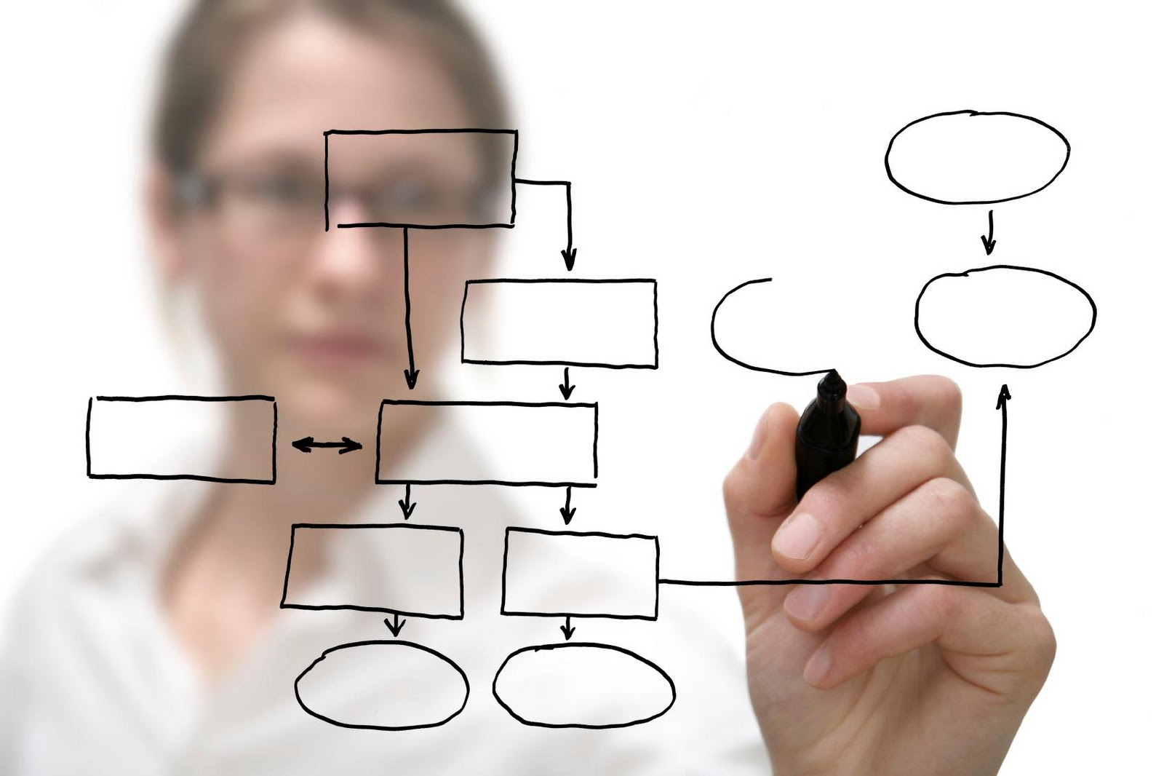
Learning Modes
Lectures/Textbook
Class Discussions
Group Project
Notes:
Most of the time, we’re in normal class mode. I will stand up here and drone at you, then toss in a joke to keep you awake
Then, because it’s boring to just listen to me talk. For me too. We’ll do a lot of group discussion. I’ll ask questions,try to get you to answer them. We’ll work through problems and examples in a group. I expect you guys to respond. I’ll stand here until someone does.
Project. Work in groups on a large-scale software project. You’ll go through each stage of development, and build a system. The idea is that you get to put the course content into practice.

Slide 22
Prerequisites
CSCE 740 - Software Engineering
Not essential, but very helpful.
We will use UML diagrams.
You need to be proficient in programming
Examples: Java, C, C++, JavaScript
You should be able to read and write programs without additional instruction.
This is not a programming language class.
You need a basic understanding of algorithms, logic, and sets.
Notes:
(read 1-2) - I know the MSE schedule is a little weird, but you should have taken that. If not, not a huge deal - we will recover the basics of design and architecture (those who took it might be a little bored), but we will also go far beyond what we covered in there.
(read rest)

Slide 23
Assignments and Grading
Group Assignments (40% in total)
Groups of 3.
Frequent peer evaluations.
Individual Assignments (10%)
Reading + 1 page summary
Midterm/Final Exams (20% each)
Participation (10%)
In-class activities.
Group participation.
Answering questions.
Notes:
1) You will work in groups of 3 students to complete assignments. Apogee students may choose to work alone or in a group. In class students must work in groups unless you have a particularly compelling reason otherwise. Now, group doesn’t mean you can slack off. There will be peer evaluations, and those will impact your grade.
2) There will also be individual reading assignments. Everyone will read the same paper and submit a one page summary.
3) Exams, the usual
4) Finally, there is a participation component to your grade. There will be in-class exercises throughout the semester. Attending and completing those will make up most of this grade. Apogee students should e-mail those within a week of the class. Your group performance and whether you take part in in-class conversations will also make up part of this grade.

Slide 24
Expected Workload
This class can be time consuming.
Understanding the material takes time.
Project work requires team coordination.
Do not underestimate the project work.
Good engineering is hard.
Planning and scheduling your time is essential.
Do NOT delay getting started.
Appoint a team leader (and rotate the role)
Notes:
project -
We’re not trying to make things arbitrairly hard to justify teamworks, but good engineering is hard - it takes time adn work
planning/scheduling is essential. most issues come from people starting too late and trying to cram. That doesn’t work here. Especially given the need for teamwork. Working together takes planning.
You can’t slack off - we do use peer evaluations in grading, and if you don’t take part, you won’t get the grade.
Team leader (read)

Slide 25
Feedback
Problems with assignments, course questions, feedback?
Contact me! I like feedback!
Problem with instructor
Also contact me
Contact CS front office
Notes:
(read). I’m new. I’m going to make mistakes. I’ll forget things, try things that don’t work out, and will change things as we go along. Don’t hesitate to contact me at any time. I want your feedback. If something isn’t working, don’t wait until the end to tell me - let me know and we’ll see what we can do about it.

Slide 26
Other Policies
Integrity and Ethics:
The homework and programs you submit for this class must be entirely your own. If this policy is not absolutely clear, then please contact me. Any other collaboration of any type on any assignment is not permitted. It is your responsibility to protect your work from unauthorized access.
Classroom Climate:
All students are expected to behave as scholars at a leading institute of technology. This includes arriving on time, not talking during lecture (unless addressing the instructor), and not leaving the classroom before the end of lecture. Disruptive students will be warned and potentially dismissed from the classroom.

Slide 27
Other Policies
Make-Up and Late Homework
Make-ups for graded activities may be arranged if your absence is caused by a documented illness or personal emergency.
Homework assignments are due at the time noted on the assignment handout. Late work is not accepted without prior approval. Any assignment turned in after the due date will be considered late and will be subject to a penalty of 10% per day, including weekends and holidays.
Notes:
(read 1-3) - A written explanation (including supporting documentation) must be submitted.
Make-up arrangements should be completed prior to the scheduled activity.
(read 4)

Slide 28
Other Policies
Diversity
Students in this class are expected to respectfully work with all other students, regardless of gender, race, sexuality, religion, or any other protected criteria. There is a zero-tolerance policy for any student that discriminates against other students.
Special Needs
We will provide, on a flexible and individual basis, reasonable accommodations to students that have disabilities that may affect their ability to participate in course activities or to meet course requirements Students with disabilities should contact their instructor early in the semester to discuss their individual needs.
Notes:
Someday you will graduate, and in the real world, you will have to work with a wide variety of people. Now is the time to abandon preconceived prejudices about others. Students in this class are expected to respectfully work with all other students, regardless of gender, race, sexuality, religion, number of tentacles, whether they pick their nose, or any other possible criteria. Real talk here - we’re a bunch of nerds, and nerds have a reputation for not knowing what to do when women are in the room. Don’t be that stereotype. There is a zero-tolerance policy for any student that discriminates against other students, regardless of the reason. Be a professional adult.
(read)

Slide 29
Stakeholders, Viewpoints, and Perspectives
Notes:
Just start with a question - want you to start thinking about this. (read)
This isn’t something with one answer, or even a right answer. It’s something we’ll keep returning to

Slide 30
A Simple Problem?
We need to replace the current stock management system. It should be more interactive and allow employees to process stock movement in real time, rather than waiting for next-day results.
First step: Gather the system requirements.
A requirement is a singular documented need that a particular product must be able to perform, or a property the product must fulfill. “The software shall be able to calculate the sum of a column of integers.”
Notes:
Let’s start with a story. (1) The time lag imposed by the current system is a real competitive disadvantage and also leads to mistakes because of the lack of immediate feedback. Now, At first glance, the problem doesn’t seem too complicated. The first step is to gather requirements. (3-4) get more complex, talk a little

Slide 31
A Simple Problem?
We talk to different people in the company:
The users at the distribution depot need different information than the users at the head office.
Commercial managers have a crucial need for real-time summary reporting.
This would slow main transaction flow, which is unacceptable to the logistics group.
The IT auditors need a two-year archive of all stock release authorizations. This introduces additional hardware requirements.
IT operations employees are not sure they can provide the needed server resources to handle two years of archives.

Slide 32
The Stakeholders
Depot users, commercial managers, logistics, IT auditors, etc. are stakeholders in the project.
“A person, group, or entity with an interest in or concerns about the realization of the architecture.”
The people for whom we build systems.
Often broad groups, rather than specific people.
The architecture must meet their complex, overlapping, and contradictory needs.
Notes:
(1-2). We often talk about users, but that is a vague term that doesn’t capture what we really care about. However, the people affected by a software system are not just endusers. Software systems are not just used: They have to be built and tested, they have to be operated, they may have to be repaired, they are enhanced, and of course they have to be paid for. Each of these activities involves a number—possibly a significant number—of people in addition to the users. (4) Each of these groups of people has its own requirements, interests, and needs to be met by the software system. This presents some problems because it may not be possible to capture and reconcile the needs of all members of the class (all users, all developers) in the time available. Furthermore, you may not have the stakeholders at hand (e.g., when developing a new product). In either case, you need to select some representative stakeholders who will speak for the group. (5) Understanding the role of the stakeholder is fundamental to understanding the role of the architect in the development of a system.

Slide 33
Stakeholder Concerns
A good architecture satisfies the concerns that stakeholders have about the project.
A concern about an architecture is a requirement, objective, intention, or an aspiration a stakeholder has for the architecture.
If a system does not meet the needs of its stakeholders, it cannot be considered a success.
Resolving conflicting concerns is a significant challenge.
Notes:
Architectures are created solely to meet stakeholder needs. Stakeholders (explicitly or implicitly) drive the whole shape and direction of the architecture, which is developed solely for their benefit and to serve their needs. (1-2)
We use the term concern here not just because the IEEE standard actually uses, but also because it is particularly appropriate to the process of architecture. As you will see when you start to develop your architecture, you are engaged in a process of discovery as much as one of capture— early in the system development lifecycle, your stakeholders may not yet know precisely what their requirements are. They might be changing their minds, they might not have thought about what they want. Architecture definition is an iterative process, where you interview stakeholders multiple times and try to negotiate with them, and discover not only what they want but what you want to do as well.
Stakeholders ultimately make or direct the fundamental decisions about scope, functionality, operational characteristics, and structure of the eventual system—under the guidance of the architect. Without stakeholders, there would be no point in developing the architecture because there would be no need for the system or anyone to build it, deploy it, run it, or pay for it. (3-4)

Slide 34
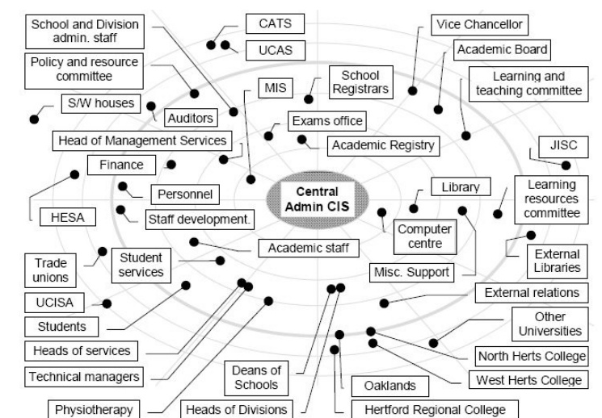
There Can Be Many Stakeholders
Notes:
Especially since the number of stakeholders can be insane. Consider something like the course website, which is powered by a software platform called Moodle. In some sense, almost every person in the university structure will be impacted by that, and most of them will have some say in how a system like that is designed and implemented. That can get tough as a developer, and this is another of those trade-offs. Who do you make happy and who do you ignore? How do you express the architecture and the requirements clearly to them so that they’re happy when they get the final system? Specifying the architecture is a key opportunity for the stakeholders to direct its shape and direction. You will find, however, that some stakeholders are more interested in their roles than others, for a variety of reasons that have little to do with architecture. Part of your role, therefore, is to engage and galvanize, to persuade people of the importance of their involvement, and to obtain their commitment to the task.

Slide 35
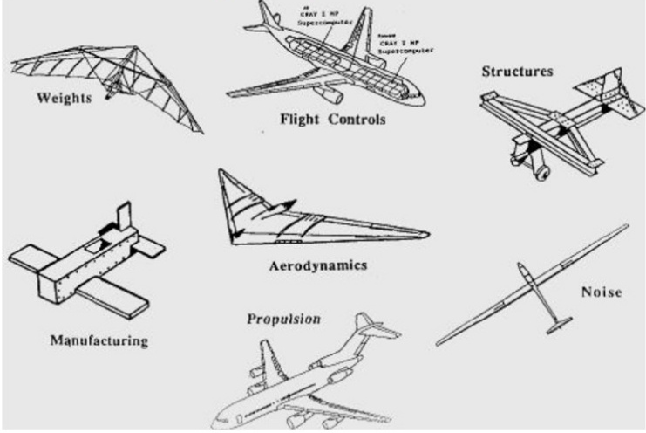
The Stakeholders
The architecture can have many meanings depending on the stakeholder’s perspective.
Notes:
Stakeholders may all interpret the requirements and the resulting architecture differently. One thing may mean something else to them. It’s not just dependent on their technical background either - if anything, that makes it worse. Show architecture for a plane to two engineers, and one might think about it from the perspective of aerodynamics, an other from the perspective of manufacturing.
You need to express the architecture in a way that they can all understand, that captures a comprehensive point of view. You need to understand what they’re looking for too, and you need to try to please these groups with different interests. This is a huge task.

Slide 36
Continuing The Story...
Armed with the requirements, you sketch the internal design of the system - identify key classes and how they work together.
The system will run in parallel, so you also describe processes and how they communicate.
You add system management components to the design to make it more manageable.
You add data stores and annotate the data flow between classes.
Now, you have an architectural model to show everybody!
Notes:
So, now you’ve interviewed your stakeholders and gathered requirements. The next step is to define how the system should work - to define its architectural design. (1) (2) To meet the concerns of the operations group, you (3). You realize you need to think more about the data in the system, so (4) (5). Great, right?

Slide 37
First Stab...
Is this model likely to please stakeholders?
Will this model represent a complete, feasible, optimal architecture?
How can you describe something as multifaceted as the architecture of a complex system to the different people who need to understand it?
Notes:
(1-2) (discuss)
If you hand this document to the stakheolders, don’t be surprised if you get bad feedback. No one will grasp the most important features of a model when presented with every detail at ones. The developers are distracted by the operational components such as servers and disk arrays, and they worry about the way the application will be deployed to the data center, which isn’t their primary responsibility. The IT operations people are pleased to see their system management software in the model, but they keep asking questions about data stores and data flows, when it seems quite obvious that it isn’t their concern. The end users don’t really understand anything and keep asking, “But what will it do?” This is a model that serves no one, and likely is not complete or optimal in any way. (3)

Slide 38
Architectural Views
Architectural views describe one aspect of a system’s architecture.
By considering a system’s architecture through distinct views, you can understand, define, and communicate a complex architecture in a partitioned fashion.
System’s functional structure.
Information organization.
Deployment environment.
Concurrent processes.
Notes:
This is a major, non-trivial challenge. We can do so through (1). This is a classic example of the principle of divide-and-conquer. (2) and avoid overwhelming a stakeholder with complex details. Some examples (rest)

Slide 39
Continuing The Story...
You develop the architecture by exploring it from different viewpoints. However…
You realize that the program is slow. Performance didn’t come up earlier - it wasn’t related to what the system was supposed to do.
The auditing group is concerned about how data access will be controlled.
Management reminded everyone that systems must recover within eight hours of a major failure.
Architecture is delivering promised features, but stakeholders might still be upset.
Notes:
(1) , and you start development, and suddenly, a few things start going wrong. (rest)

Slide 40
Quality Attributes
The architecture not only dictates what the system does, but how it does it.
How quickly it runs.
How secure it is.
How available its services are.
How easy it is to modify.
Quality attributes describe desired non-functional properties of systems.
An architect must prioritize quality attributes and design a system that meets thresholds.
Notes:
what a system does is only part of the story and that how the system provides its services often has a huge impact on the perceptions that stakeholders have of it. (rest) Designing a system that exhibits acceptable quality properties is a crucial part of your role as an architect.

Slide 41
Quality Attributes
Performance
The ability of a system to meet timing requirements. When events occur, the system must respond quickly.
Security
The ability of a system to protect information from unauthorized access while providing service to authorized users.
Safety
The ability of a system to avoid hazardous situations and act when components fail.
Notes:
Because there is a close relationship between non-functional requirements and the architecture you choose, it’s important to take those needs into account when choosing an architecture. Here are a few factors to keep in mind.
- (2) How components are structured and communicate influences performance. One of your biggest bottlenecks is often in communication between subsystems, especially over a network. So, performance can often be improved by localizing critical operations into fewer, but larger, components. Install more of your system locally, rather than on a remote server, so that computation doesn’t depend on network latency. Consider how to execute components of the system in parallel, for more efficiency.
- (4) If security is a concern, you might want to layer the architecture, with the critical components protected in innermost layers , with a high level of security validation applied to the higher layers. Architect the system to trap attackers with multiple layers of gates between them and critical assets.
- (5) If your system has any safety-critical features, the architecture should be designed so that all safety-related operations are contained within a small number of components - ideally, components solely responsible for those safety-related features. Isolating safety features from normal software functionality means that the safety features can act even in the event that other components fail. Any safety-related components should always be executed locally rather than over a network, so that they can always act to shut down the misbehaving portion of the system.

Slide 42
Quality Attributes
Availability
The ability of the software to carry out a task when needed, to minimize “downtime”, and to recover from failures.
Modifiability
The ability to enhance software over time by fixing issues, adding features, and adapting to new environments.
Testability
The ability to easily identify faults in a system. The probability that the system will fail on its next execution.
Notes:
- (2) If availability is a critical requirement, the architecture should be designed with redundancy in mind - always make it possible to replace components in case of trouble and update components without stopping the system. This is called a “fault-tolerant” system. You’ll see terms like triple reudndancy, where things like spacecraft systems will have three copies of software or hardware running at once, and makre sure they agree, or ensure that there is always a backup if something goes wrong.
- (4) If you want a high degree of maintainability, you need a larger number of small, self-contained components. That’s the idea of high cohesion and low coupling. Keep related functions together, and as independent as possible - separate data from consumers, avoid shared data structures - then you can more easily fix bugs and add features to these little independent subsystems.
- (6) Architecture has a role to play here, in that a well-designed architecture is able to amplify a failure - ensuring that you notice problems, rather than getting subtlely wrong answers or missing issues until it is too late. For instance, the architecture can determine what information is visible for inspection when testing, and a system could be designed to surface information to a special testing interface designed to provide data that would not otherwise be visible to the world.

Slide 43
Quality Attributes
Interoperability
The ability of the software to exchange information with and provide functionality to other systems.
Usability
The ability of the software to enable users to perform desired tasks and provide support to users.
How easy is it to use the system, learn its features, adapt the system to meet user needs, and increase confidence and satisfaction in system use?
Notes:
- (2) This is not useful in isolation, but is defined by context - by identifying with whom, what, and under what circumstances the system is supposed to communicate and work with .The idea here, however, is that the architecture is designed to provide the right data and functionality to external sources in a controlled manner.
(4-5) Naturally, this most centrally relates to user interfaces, but impacts the entire architecture and how users work with it.

Slide 44
Architectural Qualities Conflict
These qualities often conflict. It is hard to achieve multiple qualities at once.
Using fewer subsystems improves performance, but hurts modifiability.
Introducing redundant data improves availability, but makes security more difficult.
Localizing safety-related features usually introduces more communication between subsystems, degrading performance.
Notes:
Now, unfortuantely, emphasizing one of these qualities tends to lessen another quality. They conflict with each other.
Using a small number of complex subsystems components improves performance because there are fewer bottlenecks, but hurts maintainability, as it’s harder to add features or make changes to complex subsystems.
(read) - you need to protect all of that data equally, and that’s infinitely harder than protecting data in one place.
(read) - those safety-related subsystems are communicating with the parts of the system they govern.

Slide 45
Architectural Perspective
Quality properties are cross-cutting across all architectural viewpoints.
Architectural Perspectives are used to discuss how particular quality attributes affect each view of the overall architecture.
For example, how security impacts the functional structure, information organization, deployment environment, and concurrent processes.
Notes:
Achieving quality goals is a cross-cutting aspect of the architecture definition process and is likely to impact all of the different structures that make up your architecture. This means that achieving your quality goals is likely to affect all of the viewpoints in your architectural description. We need a better way to ensure that our architecture exhibits the quality properties required of it and to organize our knowledge about quality properties when designing the architecture. In order to do this, we use architectural perspectives. A architectural perspective is analogous to a viewpoint, but rather than addressing a type of architectural structure, a perspective addresses a particular quality property (such as performance, security, or availability) and looks at how it affects each viewpoint.

Slide 46
Framing Device for the Class
Stakeholders are the people impacted by the architecture, who have differing expectations and needs.
Viewpoints are used to structure architecture definition by focusing on aspects of the system being designed.
Perspectives focus on how a particular quality attribute impacts each viewpoint of the architecture.
Notes:
This gives us our framing device for the class - the structure I’m going to use this semester to present information.
Stakeholders are the people for whom we build systems. A key part of your role as an architect is knowing how to work with stakeholders in order to create an architecture that meets their complex, overlapping, and conflicting needs. Viewpoints are an approach to structuring the architecture process and description, based on the principle of separation of concerns. Viewpoints guide the creation of an architecture, by taking on a particular view and ignoring other elements until necessary. Perspectives are a complementary concept to viewpoints that focus on cross-viewpoint quality properties rather than architectural structures, and (3)

Slide 47
Next Time
More introduction:
Basic Architectural Definition and Styles
Reading:
David Garlan and Mary Shaw. An Introduction to Software Architecture.
On course website.
Rozanski & Woods: ch. 1 and 2
Plan your team selection.
The earlier, the better!

